Slide 1
Principles of Lean Enterprise
Presenter: Instructors Name

Slide 2
Course Outline
Know the definition of lean
Understand the difference between value added and non-value added
Develop an awareness of unevenness, overburden, and the 8 wastes
Discover several lean tools
Learn the principle of respect for people and the problem of underutilized creativity
Build awareness of push and pull workflow

Slide 3
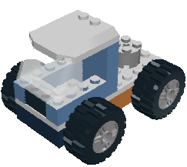
SIMULATION
Round 1

Slide 4
Rules
Positions Needed: timer, material handler, warehouse manager, assemblers & a recorder
Build trucks in batches of 5, but keep building
Use boxes, get enough parts for 5 trucks from Warehouse
Material Handler only moves batch of 5 trucks to next operation
Each Assembler then gets more parts
Build as fast as you can (more parts = more pay!)
Head down, no talking
You have 10 months (minutes) to build 40 trucks
The Boss is always right!

Slide 5
De-Brief
How did it feel?
How did we do financially?
What can we do better? How?
Breakdown Simulation

Slide 6
LEAN
The systematic and relentless elimination of waste in all its forms in pursuit of…
The Best Quality
Lowest Cost
Shortest Lead Time
Best safety
Highest morale
Continuous Improvement
Respect for people
Notes:
SYSTEMATIC
RELENTLESS
ELIMINATION
= INTENTIONAL

Slide 7


Define
VALUE ADDED
Value added activities change the market form or function of the product or service
Non value added activities DO NOT change the market form or function of the product or service

Slide 8
How much time do you think is spent on non-value added activities?
Q:
?
?

Slide 9
A:
Typical value added percentage of lead time:

Slide 10

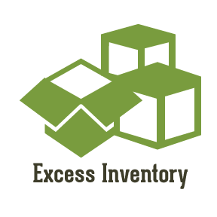




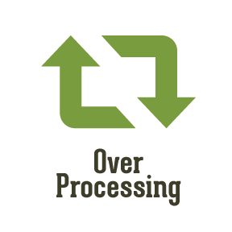

8 Wastes
Over Production
Excess Inventory
Excess Transportation
Excess
Motion
Over Processing
Waiting
Underutilized Talent
Defects

Slide 11
Over
Production
Producing more than what is needed by the next process or customer. (Too much, too soon, too fast)

Slide 12
Excess
Inventory
Excess raw materials, work in progress,
and finished goods

Slide 13
Excess
Transportation
Moving product from one
place to another

Slide 14
Excess
Motion
Excessive human movement such
as searching, reaching, or stacking

Slide 15
Over
Processing
Taking unneeded steps to produce
or modify a product

Slide 16
Defects
Producing defective product
or correcting work already done
(rework)

Slide 17
Waiting
Time spent with no activity taking place –
people waiting for parts, machines, information
or supplies

Slide 18
Under
Utilized Talent
Underutilizing people’s
knowledge and creativity
in the workplace

Slide 19
Underutilized Creativity
“
We want to not only show respect to our people, the same way we want to show respect to everyone we meet in life, we also want to respect their humanity, what it is that makes us human, which is our ability to think and feel – we have to respect that humanity in the way we design the work, so that the work enables their very human characteristics to flourish.
“
FUJO CHO – Toyota Motor Company

Slide 20

Wastes are symptoms of problems
Lean tools make the problems visible to the organization

Slide 21
Simulation
Round 2
What improvements
would you like to
make?
Notes:
Class makes suggestions on changes with limitations from instructor
Some movement of work stations, but not all
Can reduce batch size to 3
Same work instructions as Round 1 for each station

Slide 22
Lean Building Blocks –
House of Lean
+ HUNDREDS MORE!
Continuous Improvement
Pull / Kanban
Cellular Flow
TPM
Quality at Source
POUS
Quick Set-up
Standardized Work
Lot Size Reduction
Teams
5S System
Visual
Plant Layout
Value
Stream
Mapping
Notes:
Purpose: Introduce the “House of Lean”
Main point:
All of these tools are used in lean manufacturing.
Many of them utilize the same principles and build upon each other
The goal is to eliminate wastes and implement flow

Slide 23
Standardized Work
Defines operations safely carried out with all tasks organized in the best known sequence using the most effective combination of these resources:
People
Materials
Methods
Machines
Inconsistent
Process
Inconsistent
Results
Consistent
Process
Desired
Results
Without Standardized Work – there can be no sustained improvements
Implementing Lean: Part I
Notes:
Purpose: Introduce the concept of Standardized work
Main point:
Traditional manufacturing view would be to maximize one of these elements.
Without a standard there will always be inefficient variation.
This is a necessary foundation / ground level activity for lean manufacturing
Standardized work is a major component of any quality system: ISO, QSR, Malcolm Baldridge
Once we have figured out the best way we always do it in that exact manner until an even better way is discovered
Finding a better way is always controlled and measured.

Slide 24
Workplace Organization (5S)
Creates a safe, clean, neat arrangement of the workplace
Provides a specific location for everything
Eliminates anything not required.
Notes:
Purpose: Emphasize that organization of a workplace is critical to implementation of lean
Main point:
“A place for everything and everything in its place”
It is much easier to find things if you know where to look for them
This is the impression you leave with customers and suppliers of your product when they visit your factory.

Slide 25
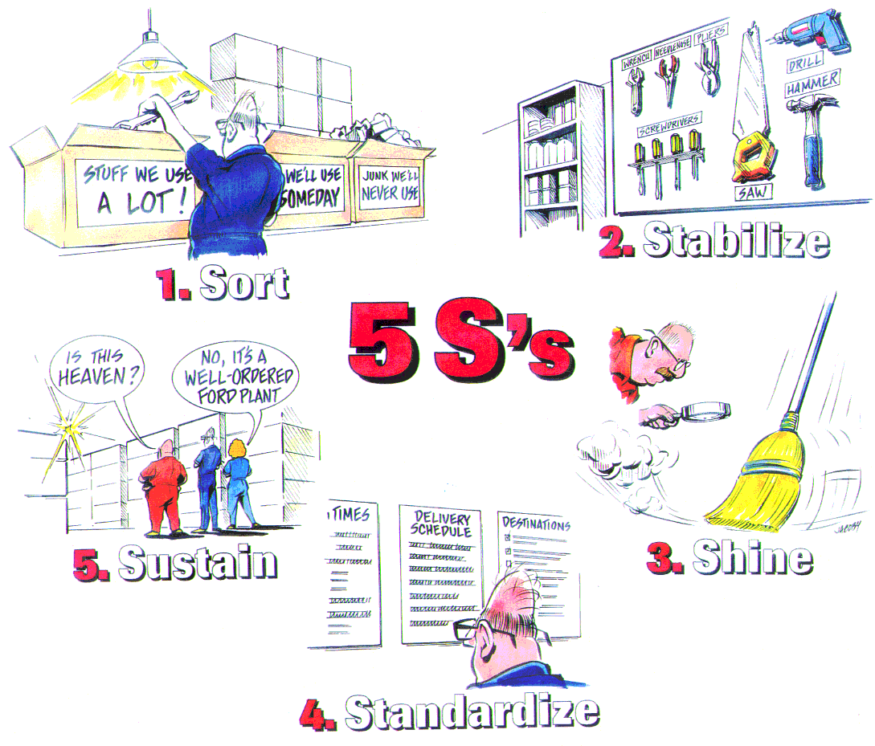
Elements of a 5S Program
2. Set in Order
1. Sort
5. Sustain
3. Shine
4. Standardize
Notes:
Purpose: Introduce the 5S program
Main point:
The 5S program is merely a way to implement good housekeeping practices
Don’t get hung up on what the S’s stand for, the basics are the same
Sort – Remove all unnecessary items such as racks, tools, containers, equipment and excess materials
Set in Order – Put what is left in order. Designate locations, use shadow boards, if there is not a designated space for something it doesn’t belong in the area.
Shine – Clean up what it left. Paint it, refurbish it, etc. Get the remaining items into the same condition as when they were new. A clean work place is much more pleasant to work in; employee morale may even be improved.
Standardize – Develop procedures that can keep things “like new”, for example house keeping and preventative maintenance. Assign responsibilities to apply these procedures. Get “affected” workgroups to make sure procedures are being utilized.
Sustain – This is the most difficult part. Don’t cut corners. Stick to the standards you develop.
This is not easy. How difficult is it to get your child to keep their room clean?

Slide 26
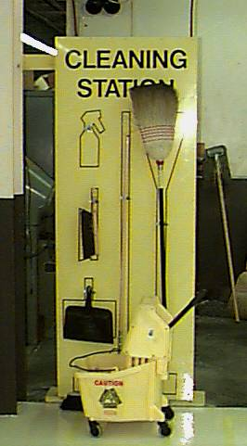
Visual Controls
Simple signals that:
provide immediate understanding of a situation / condition
are efficient, self-regulating, and worker-managed
Cleaning Station
(Is anything missing?)
Notes:
Purpose: Introduce the concept of visual controls and the power of using them
Main point:
Visual controls are waste elimination tools. They should be designed to quickly provide useful information.
They should be designed to indicate that a normal or abnormal condition exists
Examples
- Color coded dies, tools and pallets
- Lines on the floor to delineate storage areas, walk ways or work areas
- Red / Yellow / Green indicators painted on the wall to indicate inventory levels
- Cleaning station shadow board – is anything missing?
Operators don’t have to print a report or have some one tell them what to do.

Slide 27
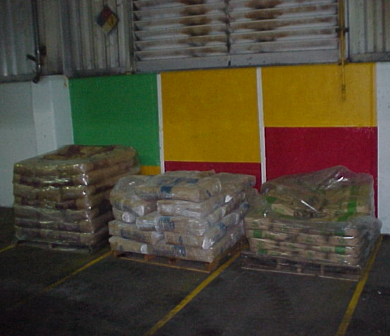
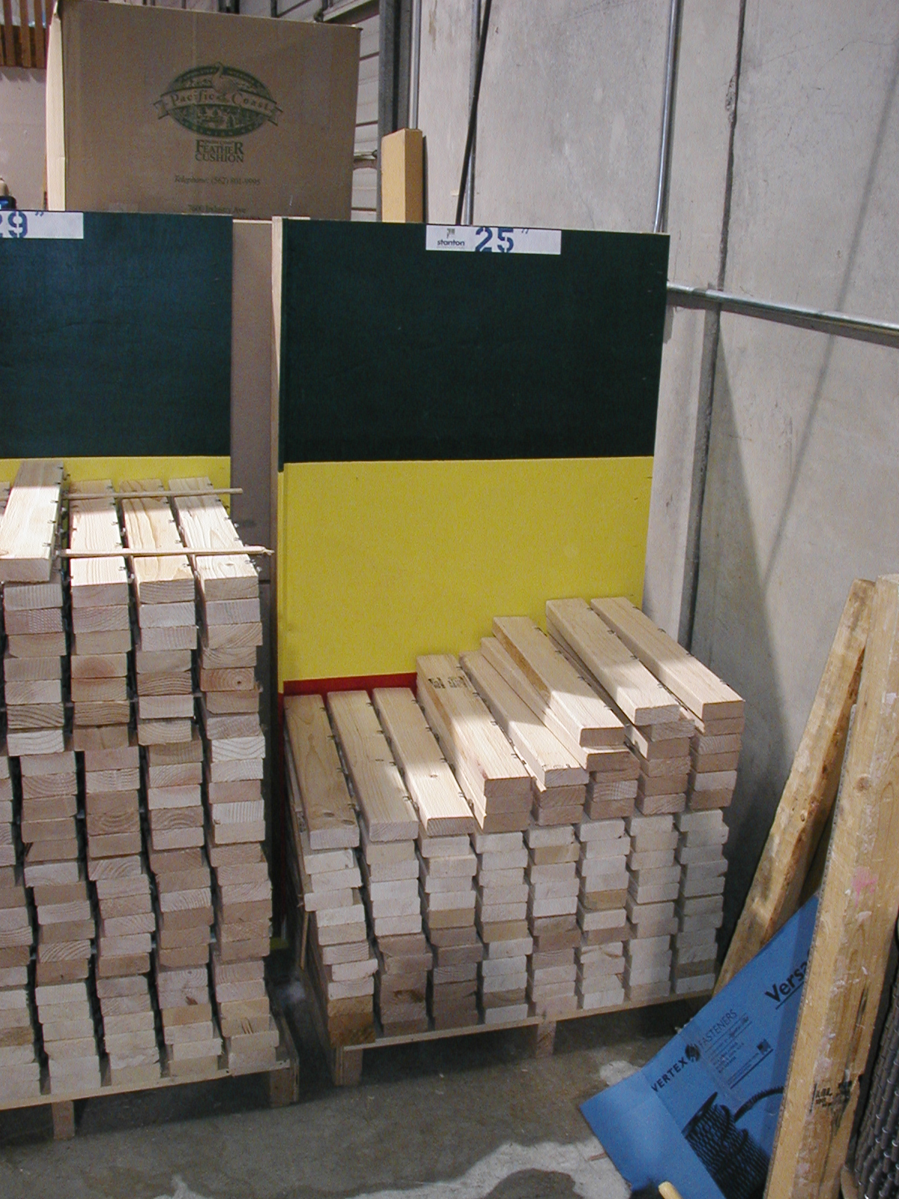
Visual Controls
Example: Inventory Management
Green = inventory levels
are acceptable
Yellow = inventory is
getting low
(Re-order next cycle)
Red = inventory is below
minimum set levels
(Re-order now!)
Notes:
Purpose: Introduce the concept of visual controls and the power of using them
Main point:
Visual controls are waste elimination tools. They should be designed to quickly provide useful information.
They should be designed to indicate that a normal or abnormal condition exists
Examples
- Color coded dies, tools and pallets
- Lines on the floor to delineate storage areas, walk ways or work areas
- Red / Yellow / Green indicators painted on the wall to indicate inventory levels
- Cleaning station shadow board – is anything missing?
Operators don’t have to print a report or have some one tell them what to do.

Slide 28
Plant Layout
Raw Stock
QC
Rec
Ship
Screw Machine
QC
Shear
Stamp
Brake
Mill
Lathe
Drill
Assembly
Weld
Grind
Finish
Parts Stock
Notes:
Purpose: Reinforce that plant layout can drive a lot of waste
Main point:
Traditional plant layouts are “functional” in nature.
They usually become departmentalized which does not promote good communication and team work.
They are usually organized by function or machines with no strategy for flowing product through the factory.
People can put a lot of “mileage” on the product as it weaves its way through the factory.
What if we discover a problem in assembly that was caused in stamping? It probably happened weeks ago, is any one going to remember?

Slide 29

Teams
Teams
Members rotate between highly specified jobs.
Cross-trained and multi-skilled employee
Work to develop operators who can work many operations within a cell and operations in different cells.
A foundation of the continuous
improvement philosophy
Notes:
Purpose: Introduce the concept of teams
Main point:
Team environments are critical to the success of Lean Manufacturing.
Cross training provides an overlap of skill sets. Companies are vulnerable if they rely on a few key people to know how to do a job.
It is critical that management fosters an environment that supports participatory decision making.

Slide 30
Impact of Size reduction
Large Batch & Queue Processing
Process
Process
Process
A
B
C
10 minutes
10 minutes
10 minutes
Lead Time:
30+ minutes for total order
21+ minutes for first piece
Small Lot Production
Process
Process
Process
A
B
C
5 minutes
5 minutes
5 minutes
Lead Time:
15+ minutes for total order
11+ minutes for first piece

Slide 31
Set-Up Time Definition
The time between the last good piece off the current run and the first good piece off the next run.
Changeover
Locate tools, dies or fixtures
Detach & attach tools, dies or fixtures
Completion
of the first
good part
Completion of last good part
Run
Part
Make Adjustments
Run
Part
Make Adjustments
1st Piece Inspection
Set-up
time
Notes:
Purpose: Introduce the concept of Set-up reduction and define Set-up
If a good part is produced with no adjustments, the run time is not part of the setup time
Main point:
Most companies focus on change over improvements where this is just a small fraction of the time invested in equipment set-up.
We have learned about standardization, How does this tie into controlling and improving set-up times?
Can any of these set-up activities be done while the machine is still running? Challenge the traditional way of setting up a machine.
SMED & FAST approach to set-up reduction.

Slide 32
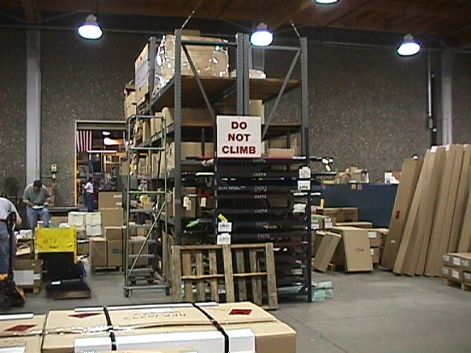
Point Of Use Storage
(POUS)
Before POUS
Notes:
Purpose: Introduce the concept of Point Of Use Storage (POUS)
Main point:
Eliminates much of the wait associated with movement.
Can eliminate or minimize counting.
Operators are not waiting on material from the warehouse or having to go get more.
Operators are not looking around for tooling.

Slide 33
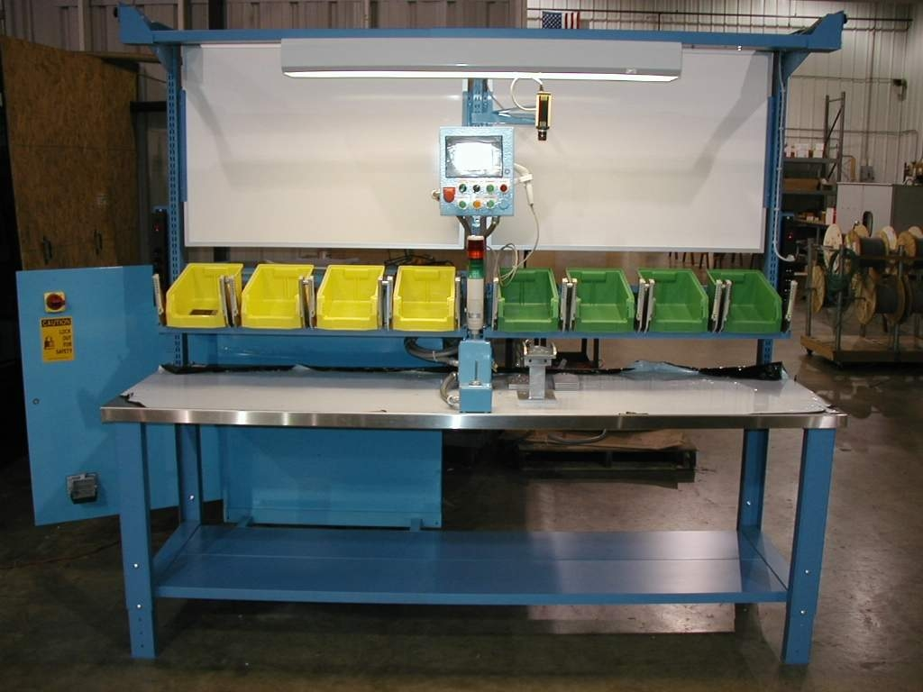
POUS
(Continued)
Raw material is stored at workstation where used
Simplifies physical inventory tracking, storage, and handling
For outside suppliers - works best if vendor relationship permits frequent, on-time, small shipments
Notes:
Purpose: Introduce the concept of Point Of Use Storage (POUS)
Main point:
Eliminates much of the wait associated with movement.
Can eliminate or minimize counting.
Operators are not waiting on material from the warehouse or having to go get more.
Operators are not looking around for tooling.

Slide 34

Quality at the Source
Source Inspection:
Operators only pass work of acceptable quality
to next work station.
Visual Tools:
Use samples, pictures, templates or established standards.
Tools and Training:
Give operators the tools and training to perform inspection at the source before they pass it along.
Notes:
Purpose: Explain Quality at the source
Main point:
Operators have a clear understanding of what is good and bad.
Root cause of defects are forced to the surface and can be addressed.
The focus is on quality not speed.
Quality can be a moving target depending upon where you are in the month.

Slide 35

Total Productive Maintenance
Eliminating the six major equipment losses:
Startup
Set-up & adjustment
Idling & minor stoppages
Reduced speed
Breakdowns
Defects & rework
How?
Analyze equipment performance
Identify root cause of problem
Implement sustainable improvements
Notes:
Purpose: Discuss Total Productive Maintenance (TPM)
Main point:
The simulation does not touch on this subject but it is an important part of maintaining flow.
Consistent and reliable equipment operation is critical to establishing and maintaining flow.
Standardize equipment maintenance with log sheets and checklists.

Slide 36

Push Vs. Pull Systems
Push System - Resources are provided to the consumer based on forecasts or schedules
Pull System – Controls the flow of resources by replacing only what has been consumed
Consists of:
Production based on actual consumption
Small lots
Low inventories
Management by sight
Better communication

Slide 37


Pull System Flow Diagram
Information Flow
Process
A
Process
B
Process
C
Customer
Supplier
Raw
Material
Finished
Goods
Part Flow
X
Kanban Locations
(signal)
X
Notes:
TIME: Max ___ minutes
PURPOSE: Demonstrate how a pull system works
KEY POINTS:
1. Production precision based on actual consumption
2. Small lots or 1 piece flow
3. Low inventories
4. Waste reduction
5. Management by site – visual controls
6. Improved communication
It is a flexible and simple method of controlling and balancing the flow of resources based on what is consumed
Pull is focused on eliminating waste of handling, storage, expediting, obsolescence, repair, rework, facilities, equipment and excess inventories (WIP & FG)
Flow diagram shows
1. customer pulls from finished goods
2. Finished goods sends an information signal to process C
3. Process C replenishes Finished goods
4. Pulls WIP and adds value
5. Information signal from Process C alerts Process B for replenishment
6. Process B replenishes C’s buffer
7. Process B pulls WIP and adds value
8. Information signal from B alerts Process A
9. Process A replenishes B’s buffer
10.Process A pulls raw material from raw material
11.Information goes to the supplier to replenish
12.Supplier replenishes the raw material
QUESTIONS:
TRANSITIONS:

Slide 38
Value Stream Mapping
6-week
Forecast
30/60/90 day
Forecast
Dealer
Network
(customers)
Production
Control
Michigan
Steel Co.
Weekly
Fax
Daily
Order
40 trucks / day
800 / month
MRP
Weekly Schedule
Tues &
Thurs
Daily Ship Schedule
Daily
I
Kitting
FI FO
Frame &
Fuel Tanks
I
Axles &
Cooling Sys.
I
Cab &
Bumpers
I
Windscreen
& Cab Final
I
Wheel
Installation
I
Final Insp.
5.0 days
5 trucks
15 trucks
35 trucks
5 trucks
15 trucks
10 trucks
.13 days
.38 days
.88 days
.13 days
.38 days
.25 days
CT = 9 sec
CT = 11 sec
CT = 13 sec
CT = 26 sec
CT = 15 sec
CT = 9 sec
CT = 6 sec
FTTQ = 100%
FTTQ = 100%
FTTQ = 40%
FTTQ = 100%
FTTQ = 100%
FTTQ = 100%
FTTQ = 40%
CO = 10 sec
CO = 20 sec
CO = 20 sec
CO = 20 sec
CO = 20 sec
CO = 20 sec
CO = 0 sec
batch = 5
batch = 5
batch = 5
batch = 5
batch = 5
batch = 5
.
O
.
.
.
.
.
.
= 1
O
= 2
= 1
= 1
= 1
= 1
= 1
O
O
O
O
O
5.0 days
.13 days
.38 days
.88 days
.13 days
.38 days
.25 days
9 seconds
11 seconds
13 seconds
26 seconds
15 seconds
9 seconds
6 seconds
Production
Lead Time =
7.15 days
Great Northern
Trucking Company
Date
Current State
Processing
Time =
93 seconds

Slide 39
Step 2: Establish takt Time
Available Work Time
Takt Time = Demand Rate =
Customer Demand
600 Seconds
40 Trucks
Takt Time =
= 15.0 Sec/truck
Cycle Time (Length of Individual Processes)
Takt Time
=
Minimum # of People
Needed per Process
GOAL: PRODUCE TO DEMAND
Notes:
Purpose: Demonstrate how to calculate Takt Time
Main point:
Takt time sets the pace for the cell. It is how often 1 part should come off of the end of the line
Smooth and steady is the goal.
The goal is to produce to the demand

Slide 40
Unevenness
Unbalanced Line
Balanced Line
Operation
Operation
Takt Time = 15 seconds
Notes:
Purpose: Demonstrate line balancing
Main point:
Don’t focus on materials, distribute the work evenly between operators to achieve a balanced line.
Each operation in the process must be less than or equal to the Takt time.

Slide 41
Overburden
COMPANY REQUIREMENTS

Slide 42
Overburden, Waste, and Unevenness
Responsible for most organizational inefficiencies
UNEVENNESS
OVERBURDEN
8 WASTES

Slide 43
Simulation
Round 3
What Improvements
Would you like to
Implement?

Slide 44
Lean Tools
Value Stream Mapping
Pull and Flow Systems
Sort, Set In Order, Shine, Standardize, Sustain (5S)
Point of Use Storage (POUS)
Batch Size Reduction
Visual Controls (Kanban)
Standard Work
Workload Balance Chart and TAKT
Layout Improvement
How many
did you get ?

Slide 45
De-Brief &
Disassemble
How did it feel?
How did we do financially?
What can we do better? How?

Slide 46
Different Production Environments
Lean is for all types of manufacturing companies
Low Volume
Medium Volume
High Volume

Slide 47

Traditional Vs. Lean
Traditional manufacturing is hard on people
Lean manufacturing is hard on process

Slide 48
Why Bother?
0% 25% 50% 75% 100%
Lead Time Reduction
Productivity Increase
WIP Reduction
Quality Improvement
Space Utilization
Typical Results Achieved

Slide 49
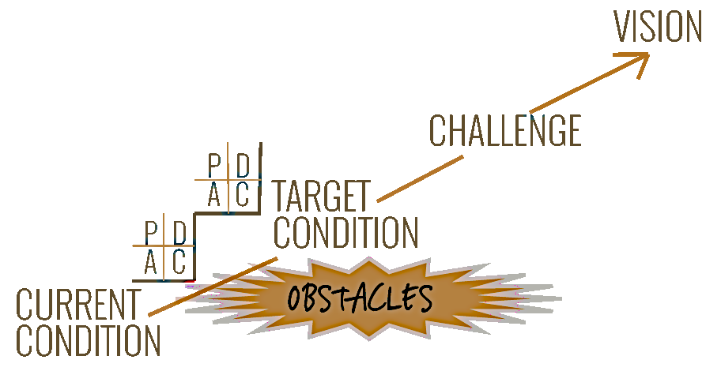
Looking Forward
Use Value Stream Mapping
We will use Current State – Future State analysis to plot a course for lean activities utilizing VSM as first step.
An incremental “Plan-Do-Check-Adjust” (PDCA) approach will be used to navigate between the current state and future state workplace.
Creative “PDCA” thinking thrives on an experimental mindset, a willingness to challenge our assumptions and ability learn from our mistakes as we go.

Slide 50
Resolve to TRY the new process & procedures
That will
take longer
than it does
now!
We would be
laughed at for
trying that!
That’s a
stupid idea!
Are you saying
we’re doing it
wrong now?
It’s too
radical!
If only it were
that easy!
Why, that’s
impossible!
We don’t do
things that
way here.
We tried that
before and it
didn’t work.
Our products
are different!
The computer
won’t let us
do that!
Notes:
Purpose: Don’t make excuses
Main point:
Drive home the point that it is not a simple process
You will have to work through a lot of preconceived notions to make this successful.

Slide 51


Questions

Slide 52
Thank You!
Instructor Name
Oregon Manufacturing Extension Partnership
Email
www.omep.org

