Slide 1
Principles of Lean Enterprise
Session 4: Lean Leadership
Presenter:

Slide 2
Stir The Paint
“Left Side”
Research, Planning & Consensus Building
Most of your time spent here
“Right Side”
Project Management
Check & Adjust
Standardize
Plan Carefully with Consensus
Implement and Learn Rapidly

Slide 3
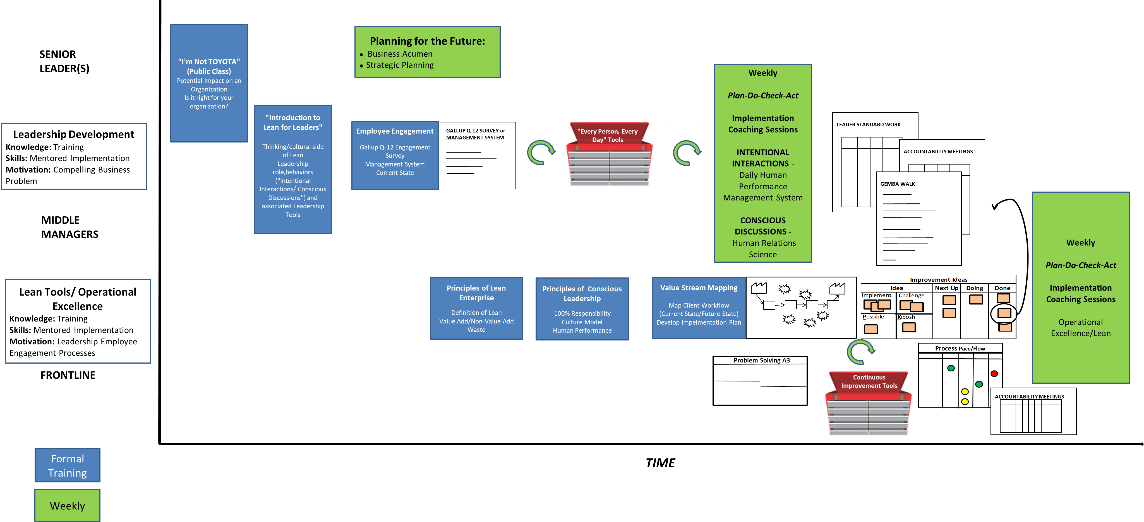
Implementing Lean

Slide 4
Implementing Lean

Slide 5

Implementing Lean

Slide 6
Learning Objectives
Know how to use the Gallup 12 as a tool
Understand personal responsibility and what it looks like
Develop skillset for delivery of clear expectations and performance measurement
Learn how to drive desirable behaviors
Build toolset for mentoring employees by using kata and 5Qs

Slide 7
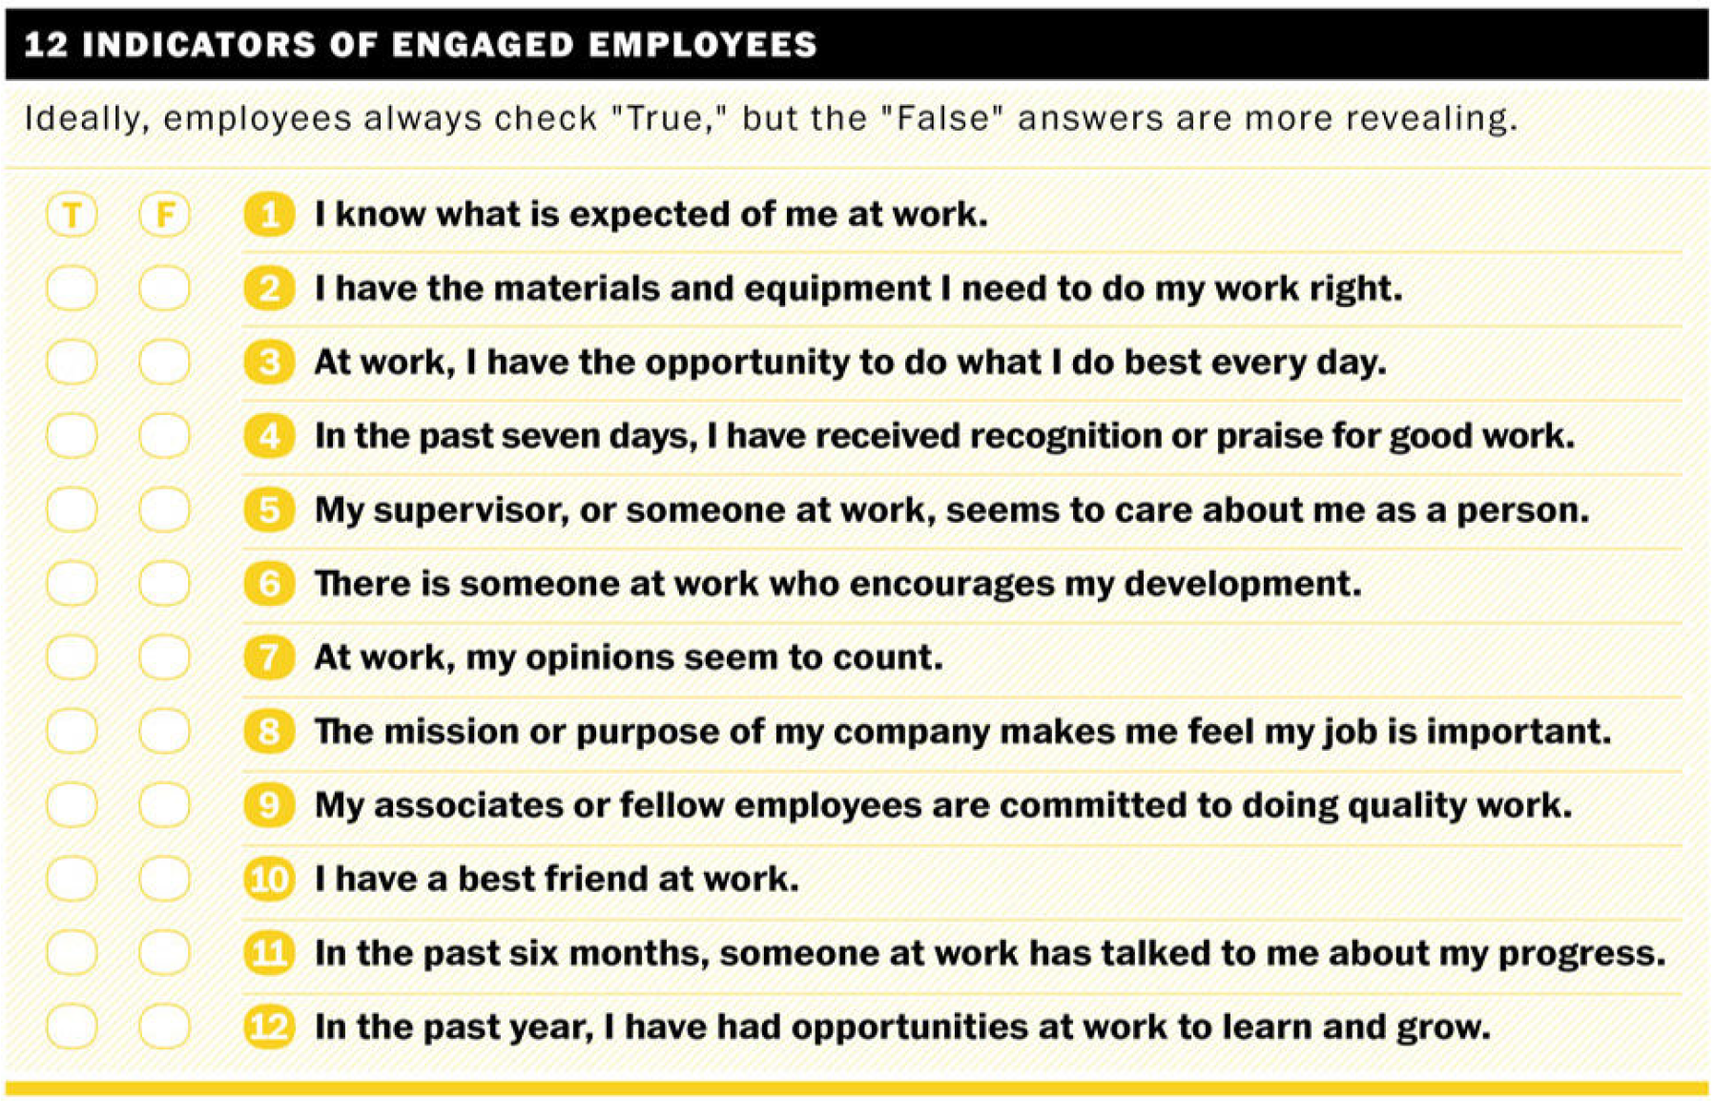
Gallup 12

Slide 8
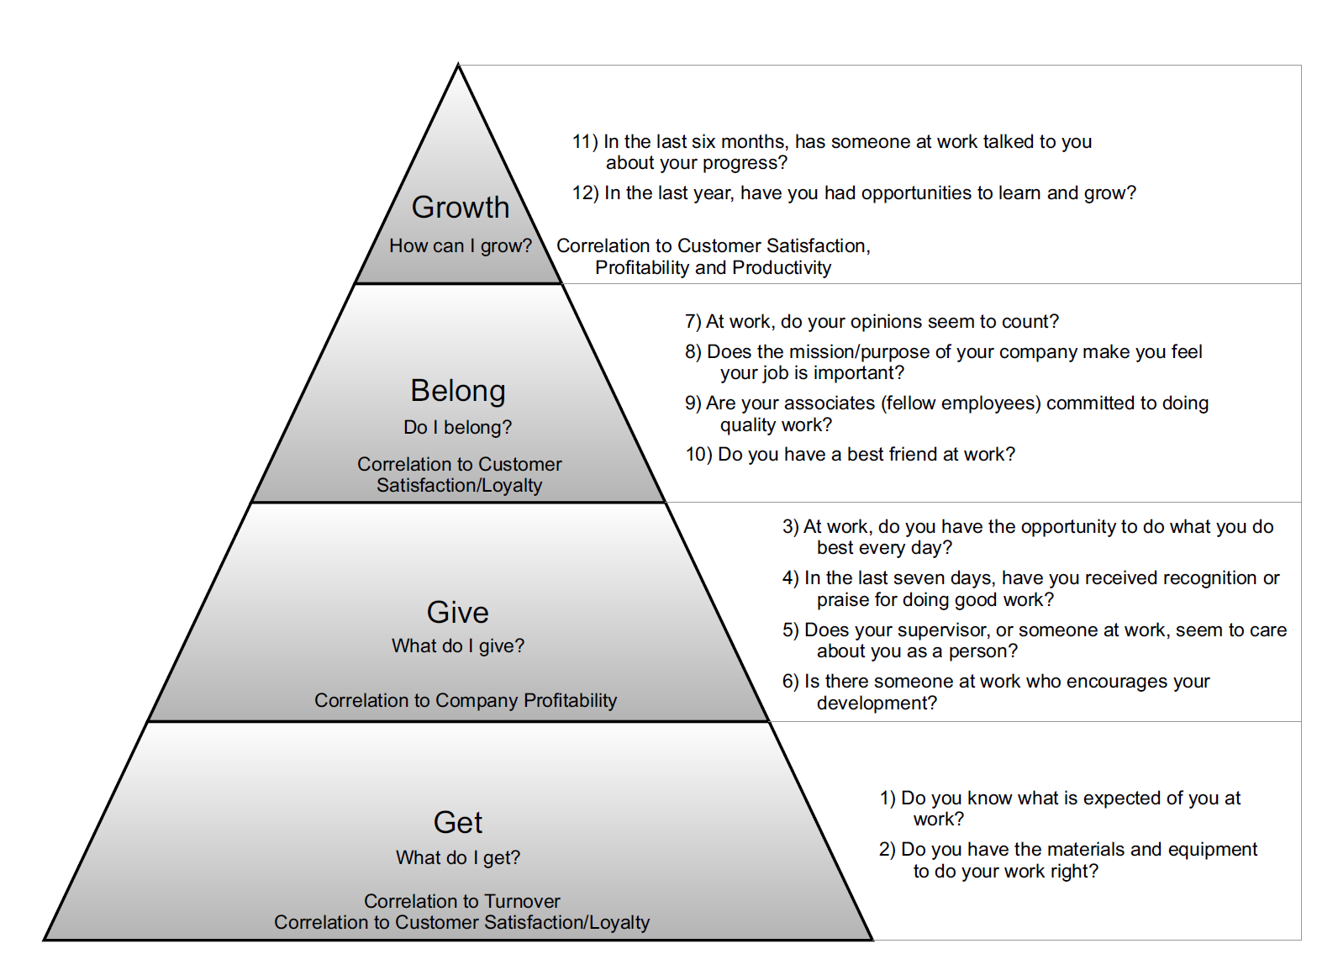
Gallup 12

Slide 9

Personal Responsibility
Name of the game: Personal Responsibility
What’s the goal: World class manufacturing!
How do we get there?

Slide 10
Behavior Vs. Attitude
Blame
Fault
Judgement
Evaluation
Interpretation
Attribution

Slide 11
Behavior Vs. Attitude
Blame & Fault
Judgement
Evaluation
Interpretation
Attribution
Subjective
Observable
Measurable
Objective
Actionable

Slide 12
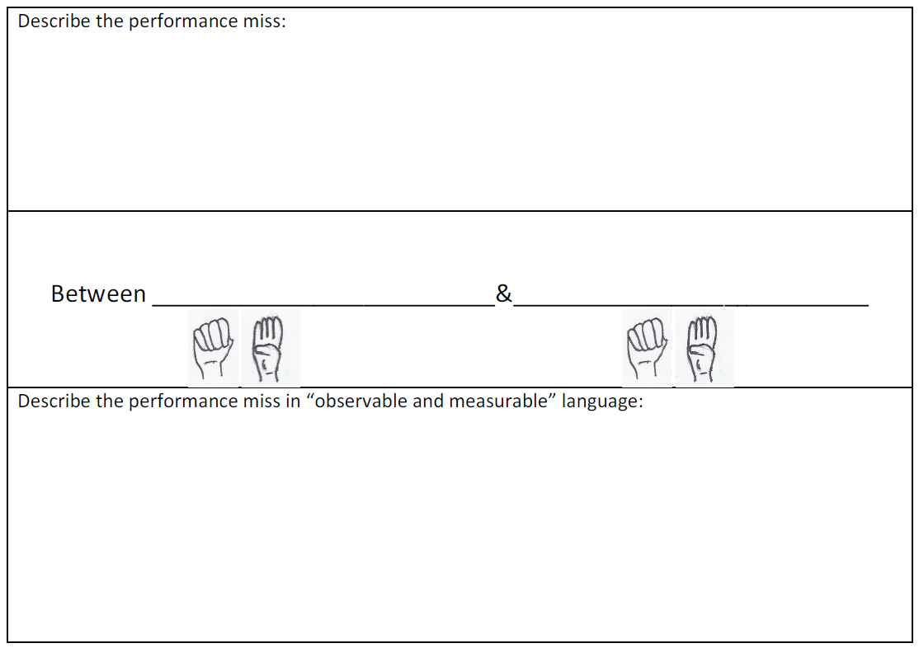
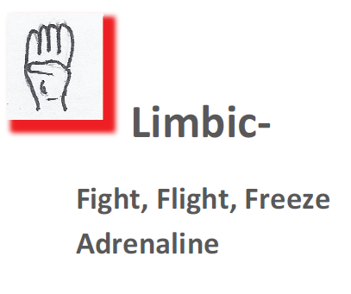
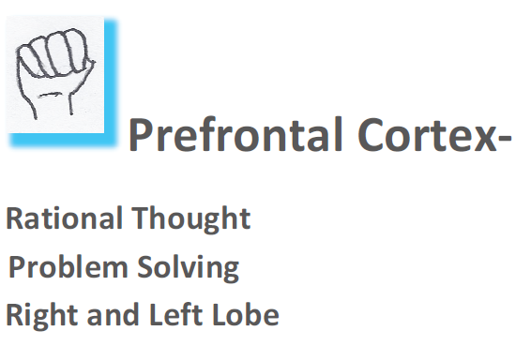
Observable & Measurable

Slide 13
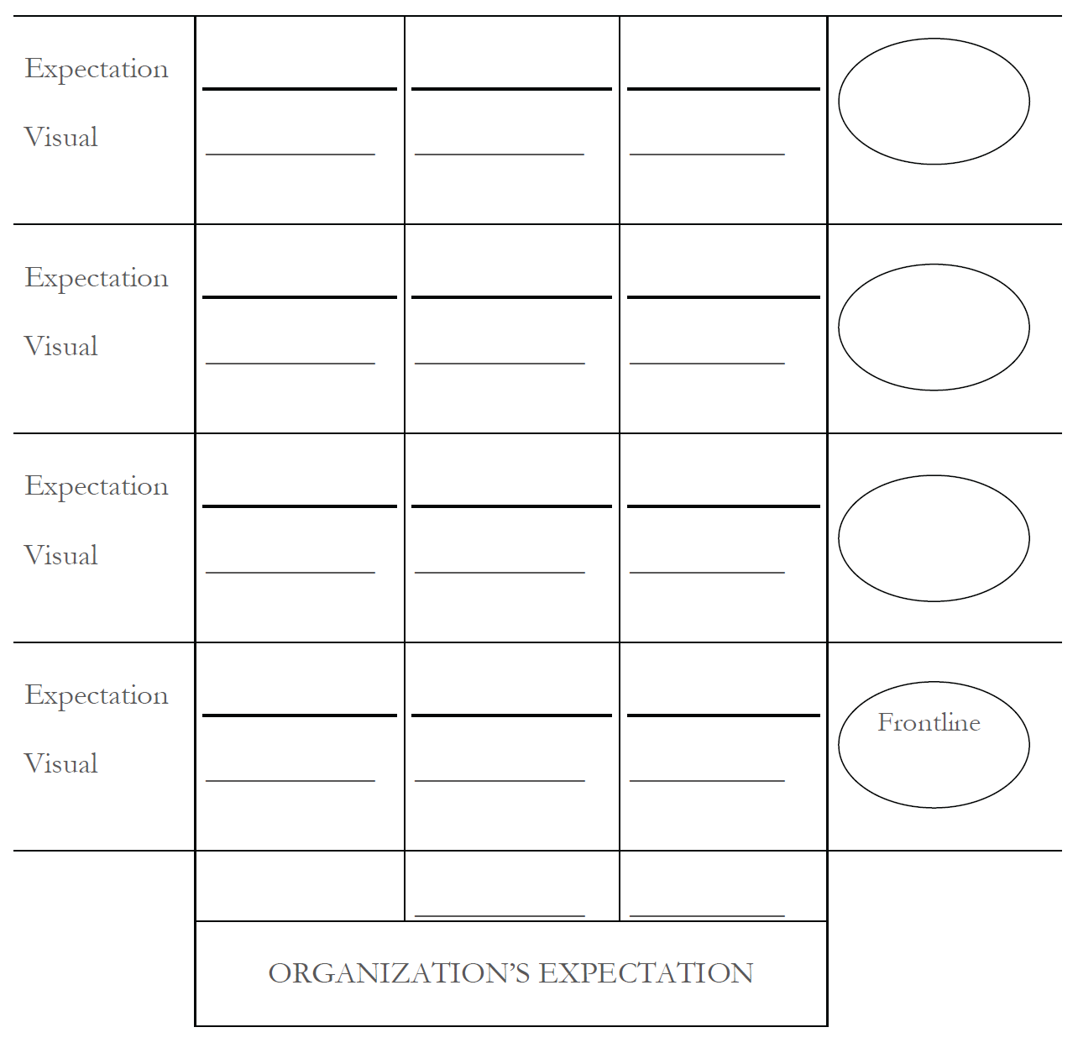
Gear, Layered Expectations

Slide 14
Leading Vs. Lagging
Process Metrics
Real Time
Predictive
Responsive
Useful for making near real time adjustments before “its too late”
Results Metrics
Retrospective
Reactive
Useful for evaluating and adjusting processes in the future

Slide 15
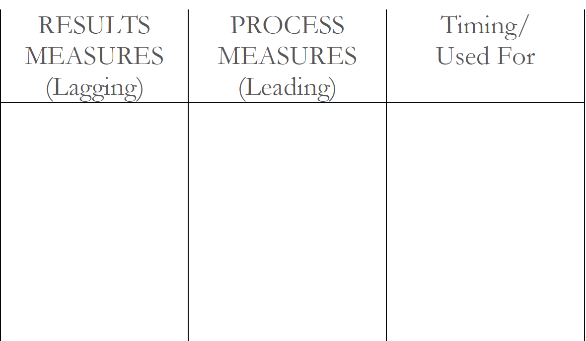
Processes Get Results

Slide 16
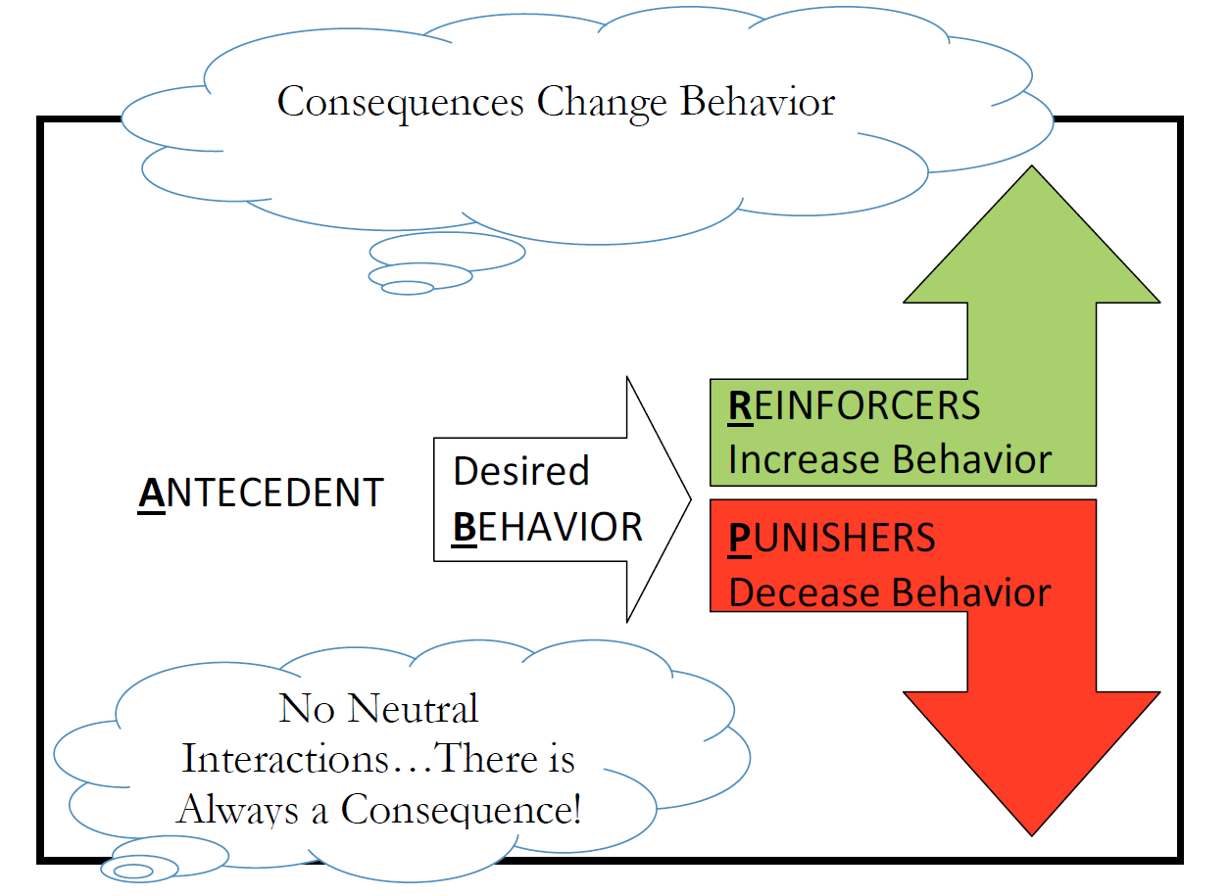
Forming Behaviors: ABC

Slide 17
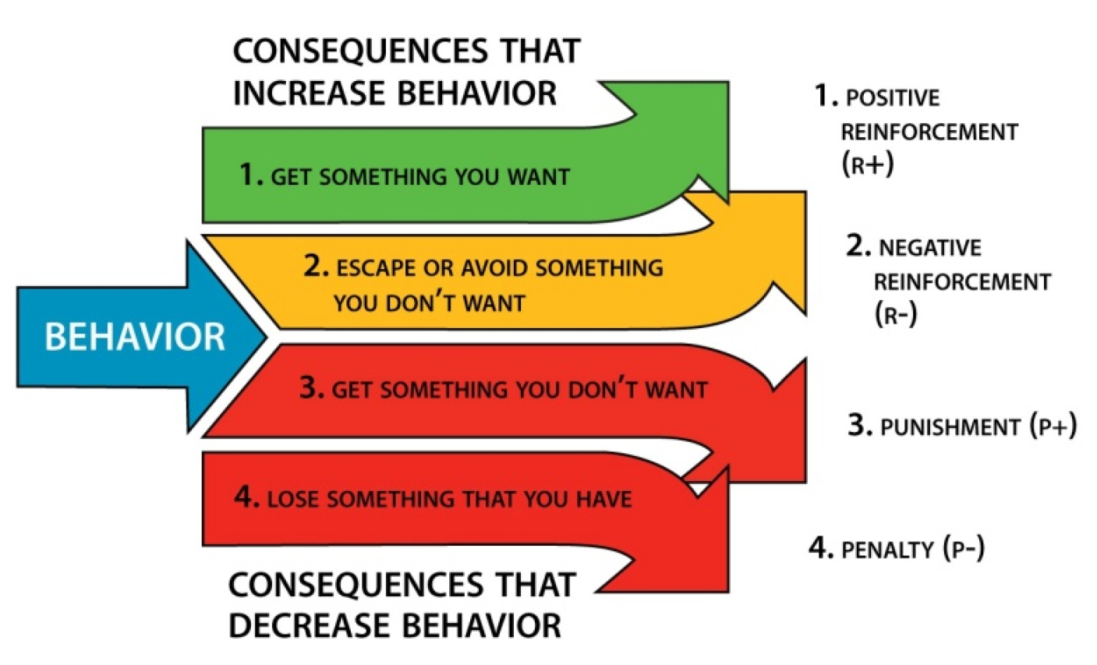
ABC Model: Consequences

Slide 18
Performance Equation
CLEAR EXPECTATIONS
+
PERFORMANCE MEASURES
+
FEEDBACK
HUMAN PERFORMANCE

Slide 19
Manager Cycle
Clear Expectations: make sure that you have communicated through both words and visuals what the organization needs each day.
Provide tools to do the work: This includes fully functioning equipment, the right tools, work standards and training necessary to safely do the work.
Observation: Go to where the work is happening and observe behaviors as they compare to work standards
Measurement: Every day measure the critical outcomes that matter most to the business. Share measurements visually in a way that makes sense to the people doing the work.
Feedback: based on observations and measurement, provide constructive and corrective feedback to your team. Problem solve with them to remove obstacles to their success.
Adjust and Update: update expectations, tools, process, etc. based on what you learned in this cycle. Prepare to run the cycle again the next day.
Set Clear Expectations
Provide the Tools
Observe Behaviors
Measure Results
Adjust and Update
DAILY
Feedback & Problem Solving
Feedback & Problem Solving

Slide 20
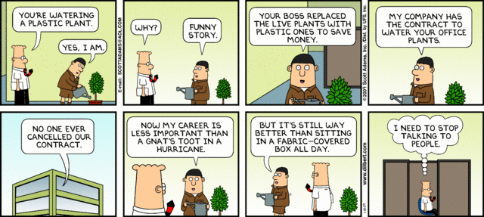
Go to The Gemba
Notes:
Develop “kaizen eyes”

Slide 21
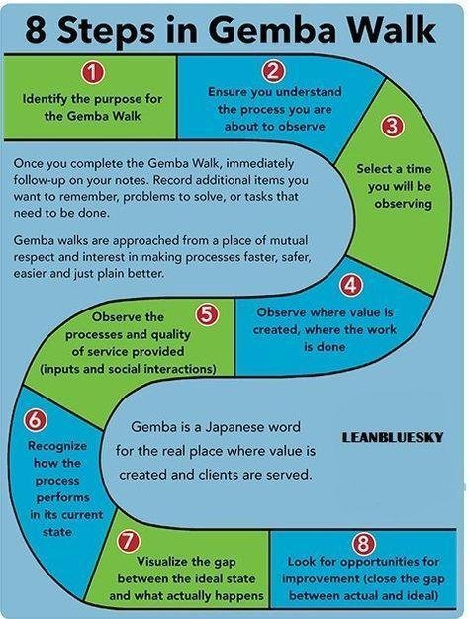
How to Gemba Walk
Notes:
Develop “kaizen eyes”

Slide 22
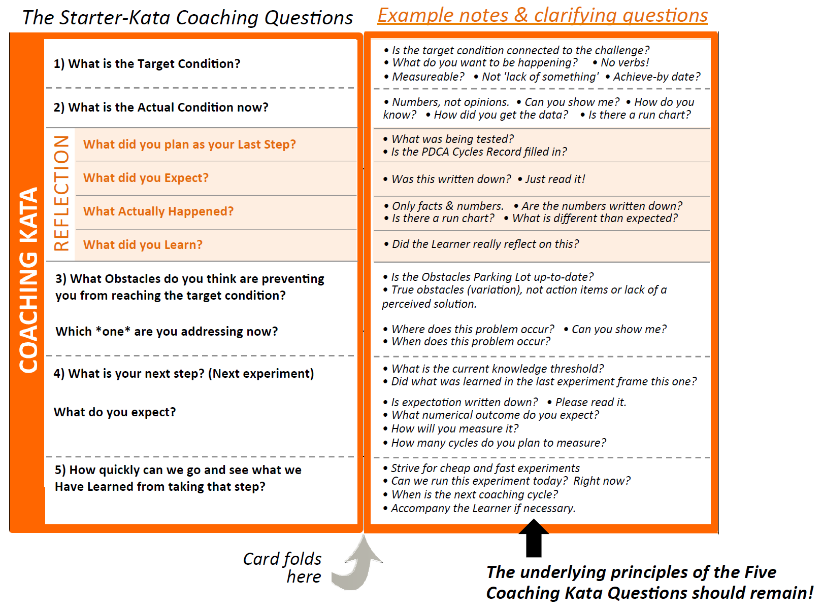
Coaching Kata
©Mike Rother
Notes:
Practice kata to find your way. No one can show you precisely how your management system should look and function – we don’t want to jump to solutions. Start with some fundamentals, just like in sports, but then go through an iterative process of experiments and adjustments to find what works best for you. – Mike Rother

Slide 23
Manager Cycle
Set Clear Expectations
Provide the Tools
Observe Behaviors
Measure Results
Adjust and Update
Clear Expectations: make sure that you have communicated through both words and visuals what the organization needs each day.
Provide tools to do the work: This includes fully functioning equipment, the right tools, work standards and training necessary to safely do the work.
Observation: Go to where the work is happening and observe behaviors as they compare to work standards
Measurement: Every day measure the critical outcomes that matter most to the business. Share measurements visually in a way that makes sense to the people doing the work.
Feedback: based on observations and measurement, provide constructive and corrective feedback to your team. Problem solve with them to remove obstacles to their success.
Adjust and Update: update expectations, tools, process, etc. based on what you learned in this cycle. Prepare to run the cycle again the next day.
DAILY
COACHING
KATA
COACHING KATA

Slide 24
Let’s Practice
“Left Side”
Research, Planning & Consensus Building
Most of your time spent here
“Right Side”
Project Management
Check & Adjust
Standardize
Plan Carefully with Consensus
Implement and Learn Rapidly

Slide 25
Personal Responsibility
BLAME
What does this look like at work?
Are you seeing this during your A3 project?
  100%
  > 100%
  < 100%
FAULT
JUDGEMENT

Slide 26


Questions?

Slide 27
Thank You!
John Hunt
Oregon Manufacturing Extension Partnership
jhunt@omep.org
(541)-289-9921

