Slide 1
Principles of Lean Enterprise
Session 3 – Intro to Problem Solving
Presenter:

Slide 2
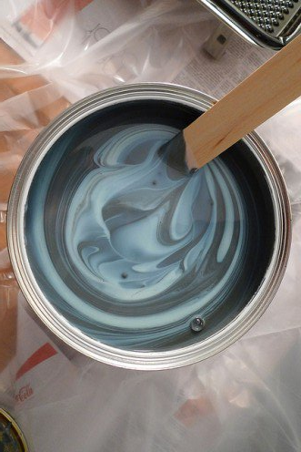
Stir The Paint
3X5 Card Activity
Lean Tools, 8 wastes, 5S Steps & Standard Work
Briefly Describe
Give example from your workplace
Notes:
Flip chart to capture wastes they saw over the past two weeks, by category

Slide 3
Learning Objectives
Know the Plan-Do-Check-Adjust cycle
Understand how to complete the entire cycle when problem solving
Develop an awareness of bias in our thought processes
Discover tools to help expose root causes
Learn how to use the A3 to systematically solve complex problems

Slide 4
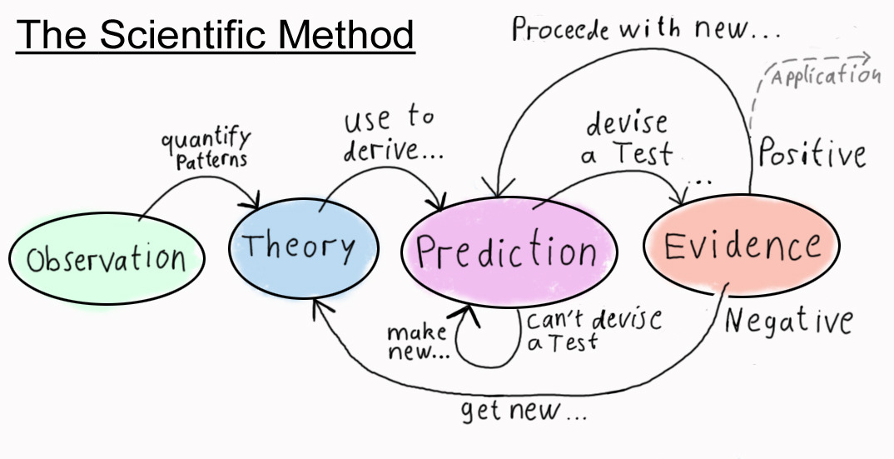
Scientific Method
What happens when our theories and predictions are wrong?
We learn a LOT by disproving our beliefs! A good experiment if falsifiable.
Notes:
When an experiment confirms what we believe, we have learned nothing new about the world. Confirmation is useful insofar as we may, for the time being, continue to use our hypothesis to develop predictions.
However, when experience refutes our hypothesis, then and only then, have we learned something new about the world and we can then create better predictions in the future.
As so many thinkers and business leaders have said one way or another: “The only true competitive advantage we have is our ability to learn faster than our competition.”

Slide 5
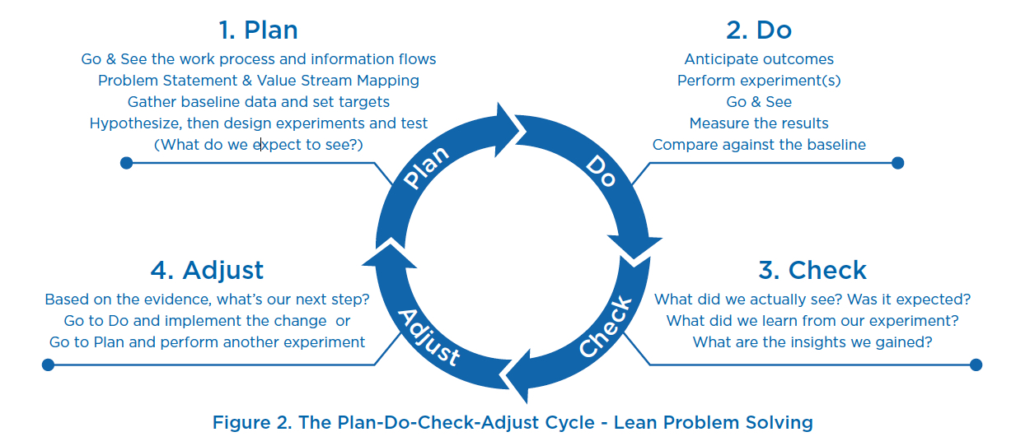
Plan-Do-Check-Adjust

Slide 6
Making Good Decisions
WRAP
Widen Your Options
Reality Test your Assumptions
  seek non-confirming information
Attain Distance Before Deciding
Prepare to be Wrong
Notes:
These are simple tools for overcoming some common biases, the list is not exhaustive but it is useful.
More on this can be found in “Decisive” by Chip and Dan Heath

Slide 7

Biases
Narrow Framing
Confirmation Bias
Short-Term Emotions
Overconfidence

Slide 8
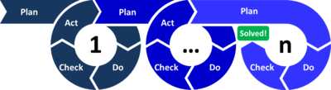
PDCA Problem Solving
Adjust
Adjust
PDCA Activity
Plan-Do-Check-Adjust

Slide 9
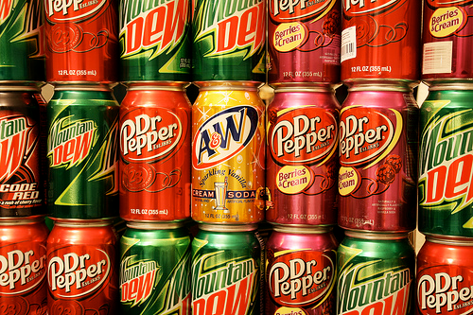
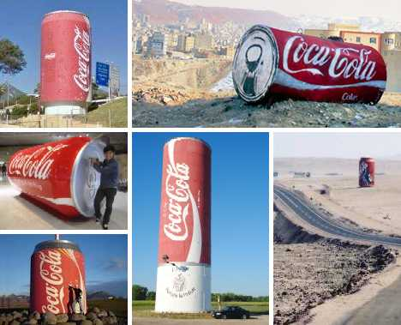

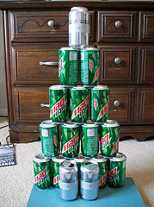
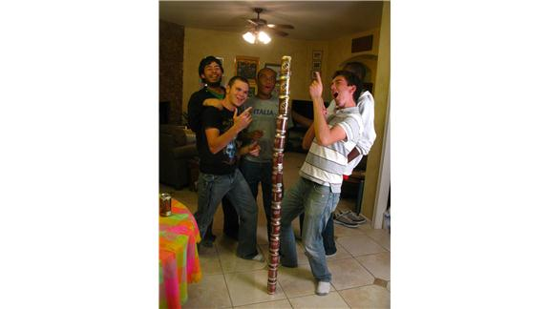

Slide 10
Straw Towers
Your team needs to design and build a 1/10th scale model of a trade show marketing platform. This ‘tower’ will be used to display 6-foot tall soda cans at trade shows and in front of mini-markets.
Using only drinking straws and masking tape
Tower must hold free standing ‘full’ can of sodas
Creativity is encouraged
Three critical features:
  Aesthetically pleasing (scale of 1-10)
  Height (2 points per inch)
  Strength (3 points per can held unassisted for minimum of 3 seconds)
Notes:
Simulation Instructions:
Divide the workshop participants into the following groups using the ratios assuming 8 participants (if you have more, try to balance to these ratios):
Sales 1, Engineering 2, Production 3, Installation and service 2
While each group is performing their individual tasks, have the rest of the group watch the ‘Toast Video’ in a separate room.
Separate the Sales team from the rest of the workshop participants
Show the sales team the videos of ‘competitors’ building soda can display towers. Give them no more information than is provided on this slide, unless they ask for it. If they ask for specific requirements say: “The can should rest no less than 2 inches off the ground”
Have the sales team communicate what they saw on the video to the engineers, providing the engineers only the information on this slide (not showing them the video).
Inform the engineers that they will be allowed 10 minutes to design a tower, but do not stop them if they go over.
Inform the production team that they will be allowed 15 minutes to build the tower to the engineers specifications.
At the end of 30 minutes, the installation and service crew will be provided three minutes to load the tower with as many cans as it can hold (the tower must stand unassisted for at least 5 seconds for cans to count). The team may stop and rearrange the cans at any time during the three minutes). If the tower successfully holds three cans, but collapses under the weight of four cans, then the team will receive the value of three cans
Measure the financial results

Slide 11
Straw Tower Calculator
Double Click on Green Field to Open Excel Spreadsheet

Slide 12

Let’s Plan
P – D – C – A
5 - 10 min
As a group, plan how to design and build the tower
Come to consensus
NOTE: Don’t start during this phase; we’re planning – not doing

Slide 13

Let’s Do
P – D – C – A
15 minutes
Execute your plan!
(Build the tower, but don’t load it up yet)

Slide 14
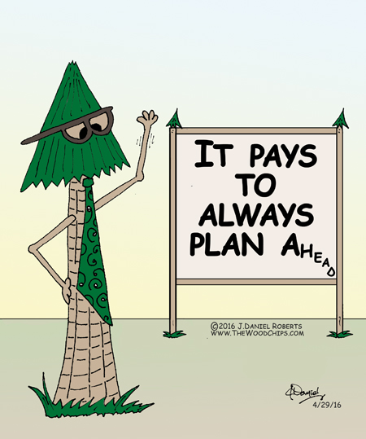
Let’s Check
P – D – C – A
5 min
Load up cans on top of the tower
Need to hold for at least 3 seconds (without touching)
Anything not go as planned?

Slide 15

Now Let’s Adjust
P – D – C – A
5 min
How could the design be improved?
How was the interactions and involvement of the various team members?
What would you do differently next time?

Slide 16
Ted Talk by Tom Wujec
Build a Tower,
Build a Team

Slide 17
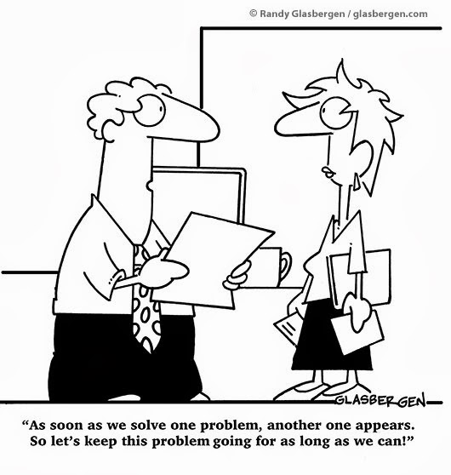
Let’s Disscuss
How does this approach compare with the way you solve problems today?

Slide 18
So What’s The Point?
When it comes to problem solving, we want to:
Improve ability to make data driven decisions
Reduce stalled, delayed and incomplete solutions
Effectively cascade new expectations
Intentionally reflect on progress and outcomes

Slide 19
Problem Solving Methods and Analysis Tools
What’s on your list?

Slide 20
Partial List of various Problem Solving Methods & Analysis Tools
PDCA
A3
Fishbone (Ishikawa or Cause & Effect)
Value Stream Mapping
Brainstorming
Pareto charts
DOE
SPC (Including Control Charts)
Process Flow Mapping
Ratings and Rankings
FMEA (Process & Design)
Scientific Process
Gantt Charts
Scatter Diagrams
“Y” – “X” Problem Trees
Multi-Variable Analysis
DMAIC (6 sigma)
Histograms
Trend Charts
BOB & WOW
Force Field Analysis
Trystorming
Finite Element Analysis
Nominal Group Process
Charting (many types)
and many others

Slide 21
Company Share
Keith Showalter
with Bob’s Red Mill
Using an A3 to reduce Changeover time

Slide 22
Toyota Principle #13
“Make decisions slowly, by consensus, through considering all options; implement decisions rapidly”
- The Toyota Way, Jeffery Liker

Slide 23
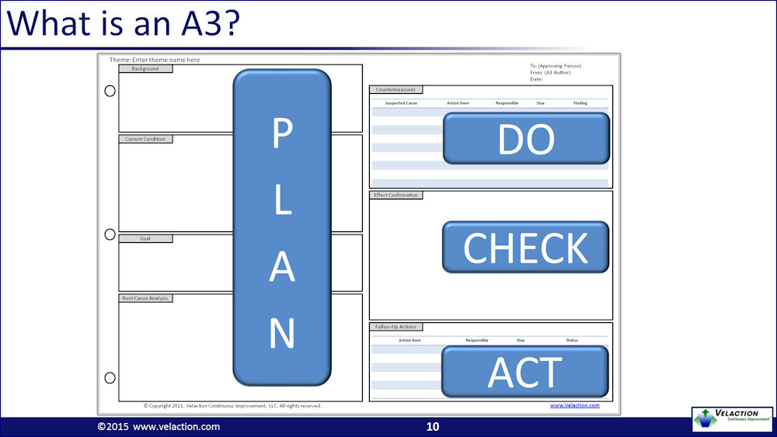
Systematic Problem Solving
ADJUST
Notes:
Living document – shouldn’t be completed in one room, in an hour or two!
A3 helps to break free from the drama triangle – bring it back to process.

Slide 24
A3 Problem Solving Structure
“Left Side”
Research, Planning & Consensus Building
Most of your time spent here
“Right Side”
Project Management
Check & Adjust
Standardize
Plan Carefully with Consensus
Implement and Learn Rapidly

Slide 25
A3 – Left Side
Plan
Do
Check
Adjust
Problem Statement
Background
Current Condition
Target Condition
Analysis
Plan Carefully with Consensus

Slide 26

Preparing the Soil
Go see what is happening, where the work is
Consider multiple concurrent alternatives
Seek input from all stake holders
Communicate visually on one piece of paper (A3)

Slide 27
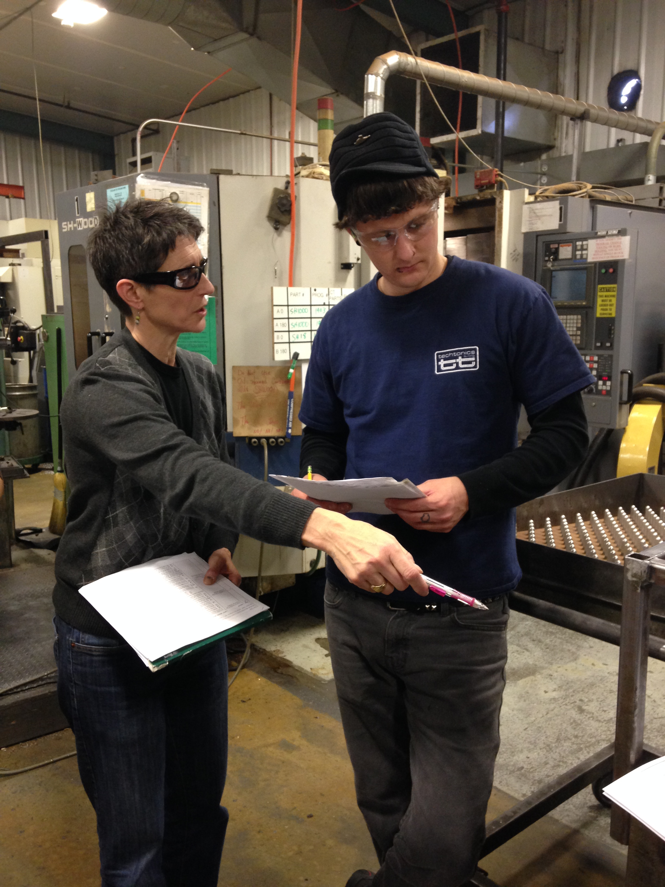
Cascading Expectations
Define the “What” and “When” (expectations, results, etc.)
Set the “Guiding Principles”
Allow the person to decide on the specific “How” and negotiate resources
Engage in multiple checks as they work the process (“prepare the soil’)

Slide 28
Problem/Opportunity Statement
GOOD PROBLEM STATEMENTS
Lead time reduction initiative to capture
revenue premium on
“quick turn” product.
Receiving chain lost time injury reduction project
POOR PROBLEM STATEMENTS
Equipment issues causing long lead times and lost revenue opportunities
Emergency stop upgrade to reduce lost time injuries on receiving chain
Notes:
Create a brief, objective description of the problem or opportunity that neither implies cause or solution. Don’t lead the witnesses ☺

Slide 29
Background (text)
Example
Customers will pay at least a 3x price premium on product delivered within 12 days; with current lead times averaging 20 days we are losing significant revenue opportunities.
In recent years, reliability has become less of a differentiating factor in customer decisions. However short lead times, especially on prototype and critical components, has become increasingly valuable. Our last significant lead time breakthrough was 8 years ago when…
Business Case
Brief History
Notes:
Background tells me why I should care and how we got to where we are now (not root cause)
When you are done with background, key stakeholders should all agree that there is something worth pursuing and putting resources into.
Some useful tools would be a timeline that shows history of Lead Time, significant changes in market focus, or changes in core technologies used by the company.
Additionally a graph comparing company revenue and revenue per labor hour under a short and long lead time environment would be helpful.

Slide 30
Activity – Part 1
In Groups:
Complete “Problem Statement” and “Background” for your company’s issue

Slide 32
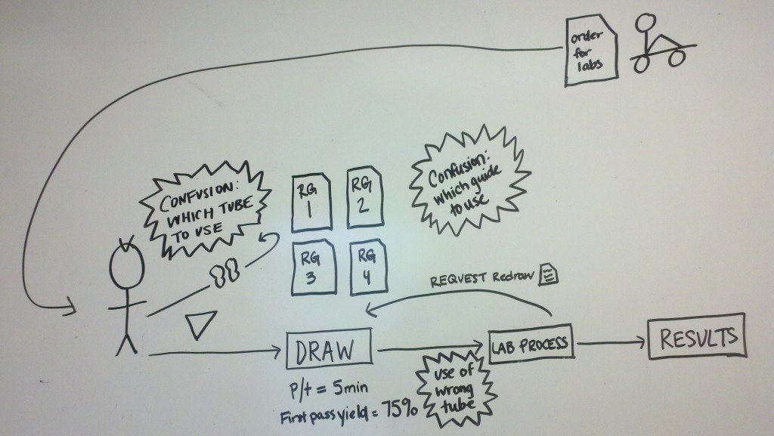

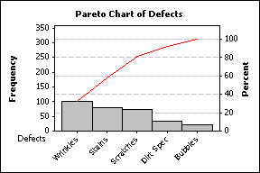
Current Condition
This is an ACTIVITY – Go see!
Reflect AS-IS, not should be – include real variations and exceptions
Make it VISUAL – don’t use buckets of words!
THIS IS IMPORTANT! Problem solving often fails because team didn’t fully understand the current condition
Visual tools:

Slide 33
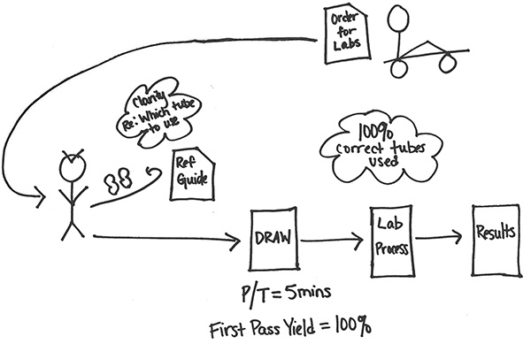
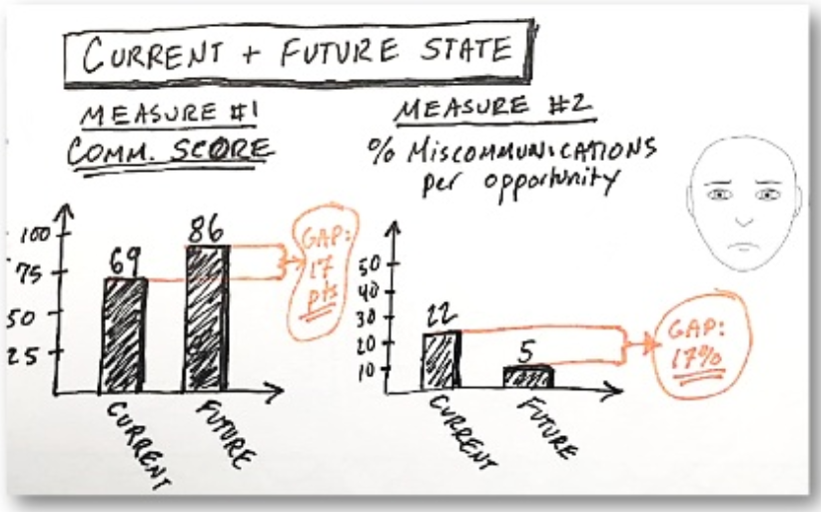
Target Condition
Visual tools:
What’s the IDEAL condition?
  No work-arounds
  No re-work
Can we measure the gap between current and target conditions?
1° shifts!

Slide 34
Activity – Part 2
In same group:
Complete “Current Condition” and “Target Condition” for your A3
As needed:
Identify what additional data and/or observations would help clarify the “Current Condition”
Conduct a “Gap Analysis” between the current and target

Slide 35
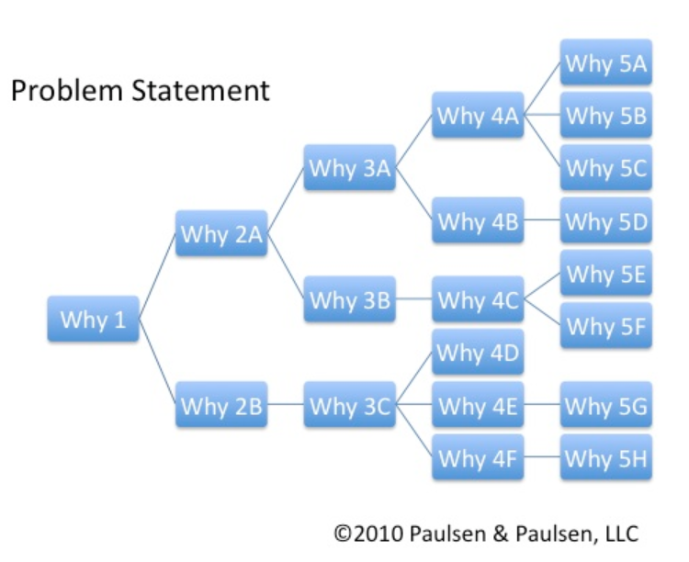
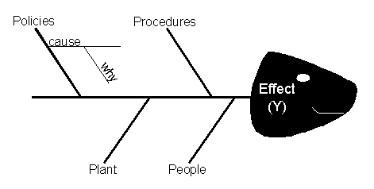
Analysis
What would have to be different for our target condition to be reality?
Work to get to the root(s) of the problem
Use tools to stay focused and visual
  Five Whys
  Fishbone diagram
  Pareto analysis
  List of other methods
Selecting the appropriate method
Conduct experiments to (dis)prove your beliefs!

Slide 36
Sample Pareto Anlysis
Insert Q&D (Lily) samples

Slide 37
Analysis – Part 3
As a group:
Identify planned “Analysis” tool
What problem solving methods or analysis tools would be helpful in determining the “Root Cause” of the issue?

Slide 38
A3 - Right Side
Plan
Do
Check
Adjust
Prioritized Action Items (brainstorm and narrow)
Project Plan
Evaluate Results (check and adjust)
Standardize and Share
Implement and Learn Rapidly

Slide 39
Project Management
Share various Project Management methods
What are the Pros and Cons of the various methods?

Slide 40
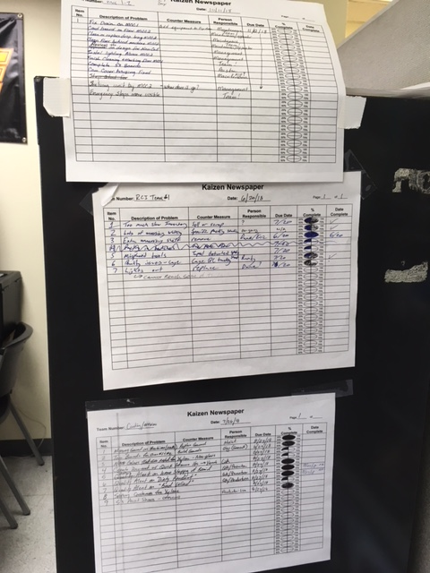
Sample Kaizen Newspapers

Slide 41
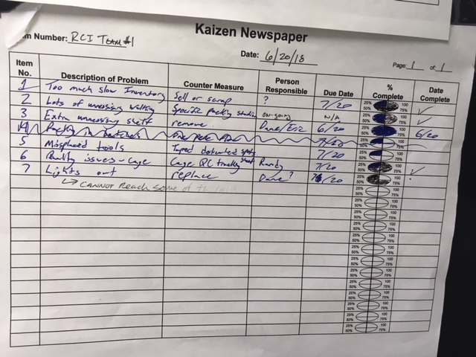
Sample Kaizen Newspapers

Slide 42
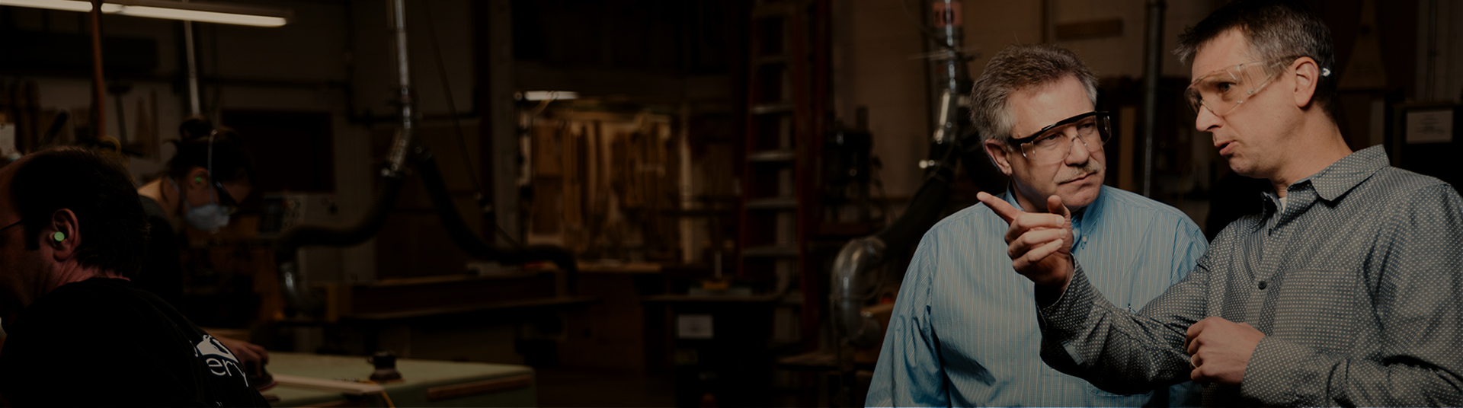
Check and Adjust
Be intentional about when you will meet and review
Follow the Kata…
  What did you expect
  What actually happened
  What was the reason for the difference
  What will you try next (experiment)
  When can I come see what you’ve learned.

Slide 43



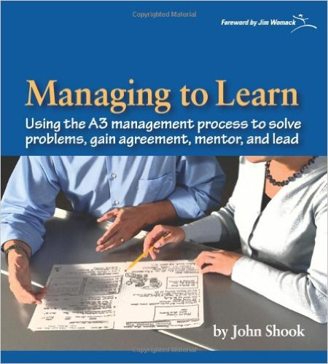
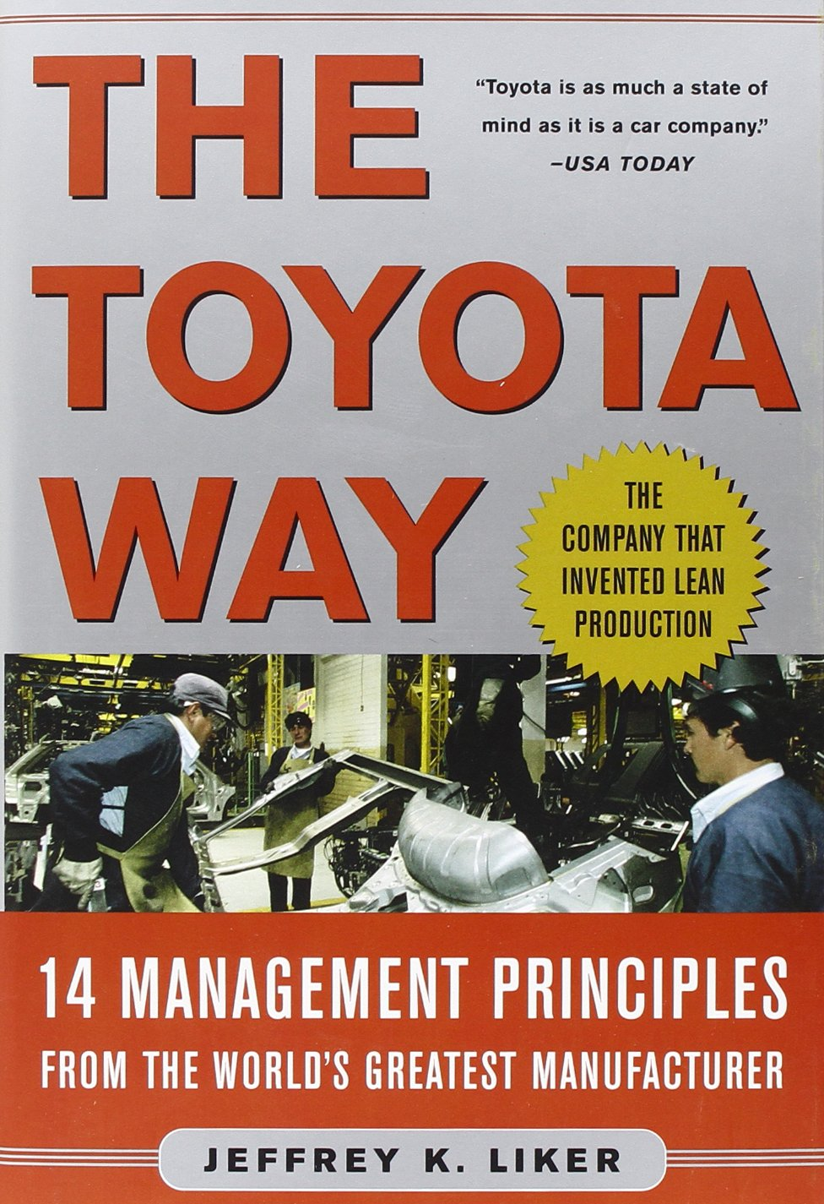

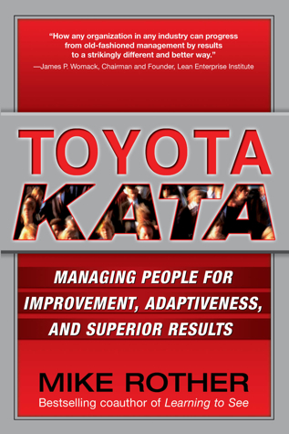

Slide 44
Example of Team Problem Solving
Notes:
Workshops are one tool to use for improvement -- other tools include Pre-Production Preparation (3P), Distribution Kaizen, and Total Productive Maintenance (TPM).
People issues MUST be addressed before the workshop week - work schedule conflicts, union issues, non-participant communication.
Emphasize points critical to the success of the workshop.
Clearly defined statement of work
Early planning and communications
Collection and preparation of baseline data for analysis
Following the workshop process steps
Address people issues immediately
Good support from management and peers
Linking to other improvements and the business plan
Follow up to complete longer-term issues and hold the gains.

Slide 45


Questions?

Slide 46
Thank You!
Robin Klein
Oregon Manufacturing Extension Partnership
503-984-3974
H.Robin.Klein@gmail.com

